Slide 1
Abstract algebra ch 19 vector spaces

Slide 2
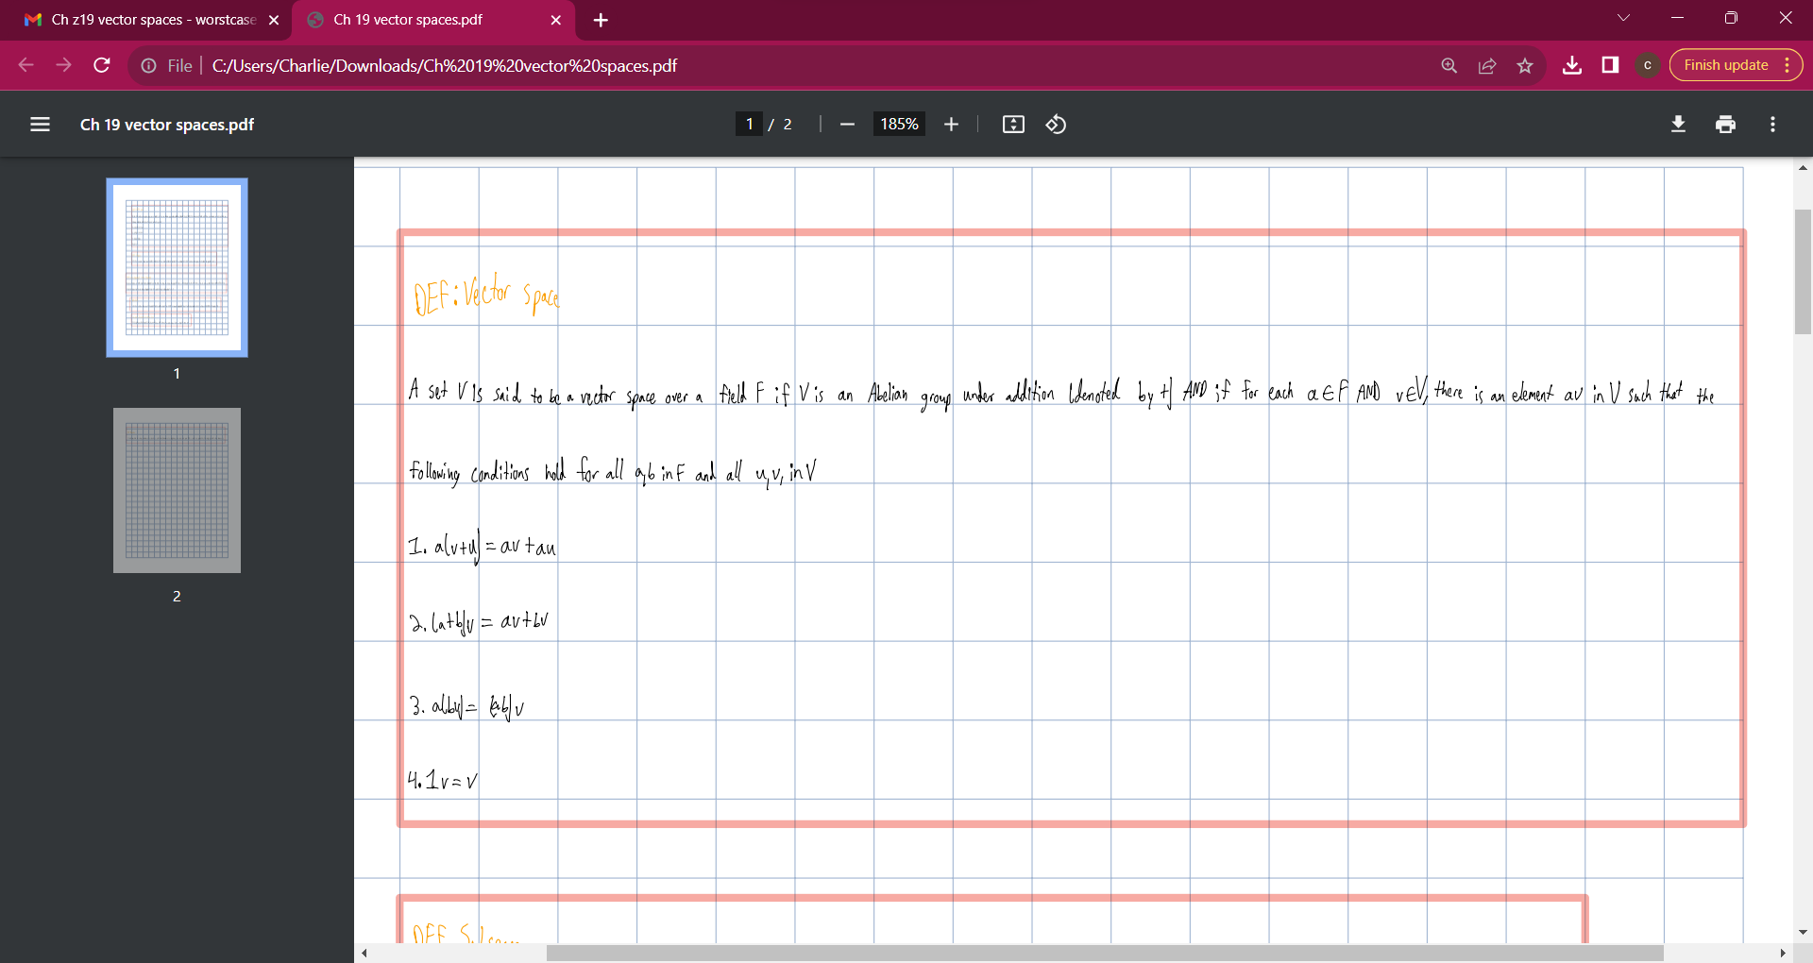

Slide 3
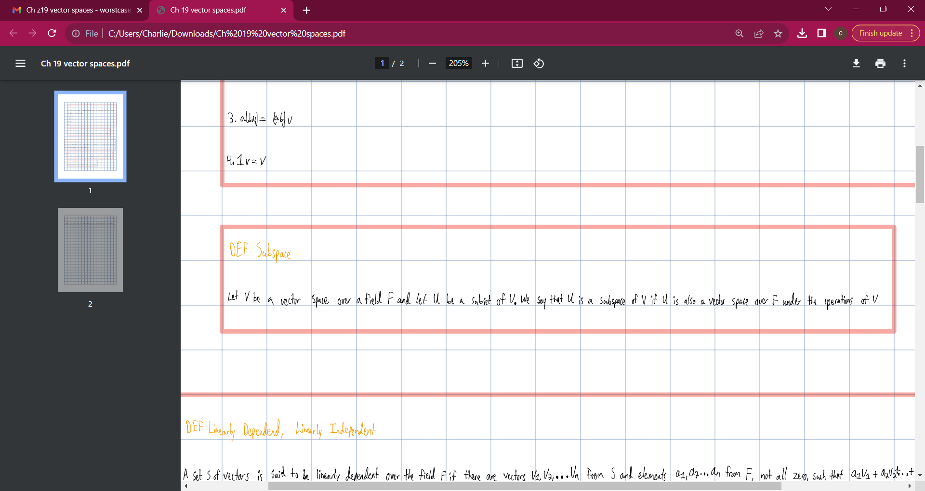

Slide 4
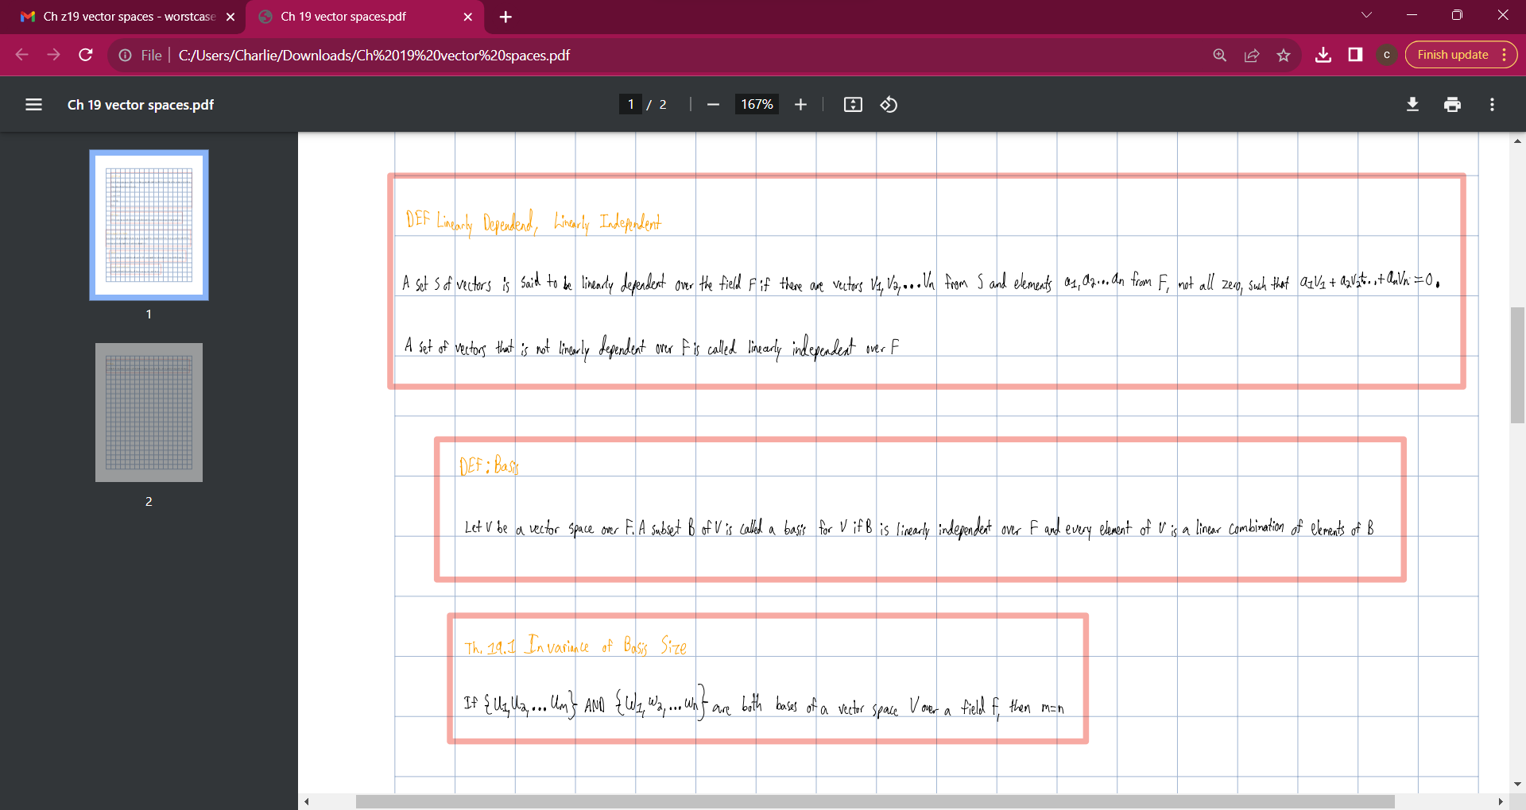

Slide 5
